Slide 1
Principal Component Regression (PCR)

Slide 2
Contents
Multiple Linear Regression-Quick Recap
The Problem of Multicollinearity
Principal Component Analysis – General Approach
Principal Component Regression (PCR)
Introduction
Statistical Model
PCR in R

Slide 3

Multiple Linear Regression: Statistical Model
$$Y= b_{0}+b_{1}X_{1}+b_{2}X_{2}+ … +b_{p}X_{p}+e$$
Where,
Y : Dependent Variable
X₁, X₂ ,…, X_{p} : Independent Variables
b₀, b₁ ,…, b_{p} : Parameters of Model
e : Random Error Component
Independent variables can either be Continuous or Categorical

Slide 4
Problem of Multicolinearity
if there is a strong linear relationship among independent variables.
Multicolinearity exists
Highly Unstable Model Parameters As standard errors of their estimates are inflated
Consequences
Model Fails to predict accurately out of sample Data
Multicolinearity is detected using Variance Inflation Factor, VIF
Tolerance = 1- R_{i}²
VIF = 1/Tolerance
where R_{i}² (R Squared) is obtained using regression of Xi on other independent variables
Any VIF > 5, indicates presence of multicollinearity

Slide 5
Multicollinearity – Remedial Measures
The problem of Multicollinearity can be solved by different approaches:
Drop one of the independent variables, which is explained by others
Use Principal Component Regression in case of severe Multicollinearity
Use Ridge Regression

Slide 6
Principal Component Regression
In Principal Component Regression,
Each PC is a linear combination of all X variables
Final model is expressed in terms of original independent variables for ease of interpretation
First k principal components are used as independent variables instead of original X variables

Slide 7
Principal Component Regression
Transformation into PCs
The original p variables are transformed into a new set of orthogonal or uncorrelated variables called “Principal Components “
In the second step, after elimination of the least important principal components, a multiple regression analysis of the response variable against the reduced set of principal components is performed using the OLS estimation
Regression Analysis
Back Transformation
In the third step, model equation is back transformed in terms of original variables.

Slide 8
PCR-Statistical Model
Model in terms of original X variables:
Model in terms of Principal Components:

Slide 9
Case Study
Background
Objective
Available Information
A company periodically records data for sales and expenses. The company wishes to model the relationship between its sales and sales related expenses and obtain predictions
To predict incremental sales based on planned sales related expenses
Sales is the Dependent Variable
Data available for 143 micro business zones
Expenditure towards advertisements and promotions in the current and previous months are Predictors

Slide 10
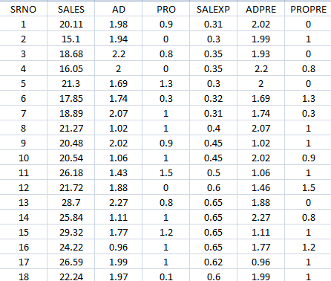
Data Snapshot
Dependent variable
Independent variables
Columns | Description | Type | Measurement | Possible values
SRNO | Serial Number | - | - | Intergers
SALES | Incremental Sales | Numerical | INR Million | positive value
AD | Current Advertising Expenses | Numerical | INR Million | positive value
PRO | Current Promotional Expenses | Numerical | INR Million | positive value
SALEXP | Misc. Sales Expenses | Numerical | INR Million | positive value
ADPRE | Previous Period’s Advertising Expenses | Numerical | INR Million | positive values
PROPRE | Previous Period’s Promotional Expenses | Numerical | INR Million | Positive value
Observations

Slide 11
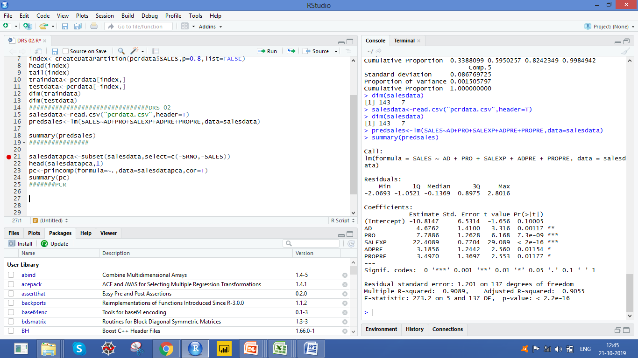
PCR in R
# Import csv file “pcrdata”
salesdata<-read.csv("pcrdata.csv",header=T)
# Fitting a Linear Model :
predsales<-lm(SALES~AD+PRO+SALEXP+ADPRE+PROPRE,data=salesdata) summary(predsales)
lm() fits a linear regression model.
summary() generates model summary.
# Output of summary
Interpretation:
Multiple R-Squared is 0.9089, showing model to be a good fit.

Slide 12
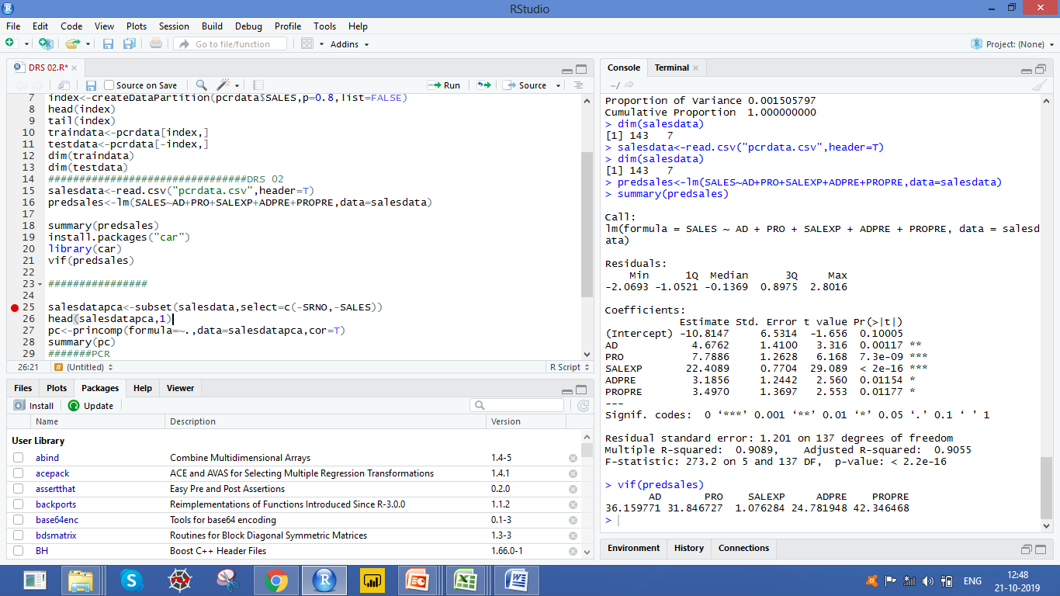
PCR in R
# Checking for Multicolinearity
install.packages("car") library(car) vif(predsales)
vif() in package car calculates VIFs.
# Output of VIF
Interpretation:
VIF values are very high (>5, except for SALEEXP) indicating severe multicolinearity problem.

Slide 13
PCR in R
# PCA in R
# Subsetting data for getting Principal components and performing PCA
salesdatapca<-subset(salesdata,select=c(-SRNO,-SALES)) pc<-princomp(formula=~.,data=salesdatapca, cor=T) summary(pc)
princomp()from base R performs PCA on the
given numeric data matrix
formula= contains the numeric variables. ~.
ensures all variables are taken
cor=T indicates that calculations should be done
using the Correlation Matrix.
summary() generates the summary of PCA

Slide 14
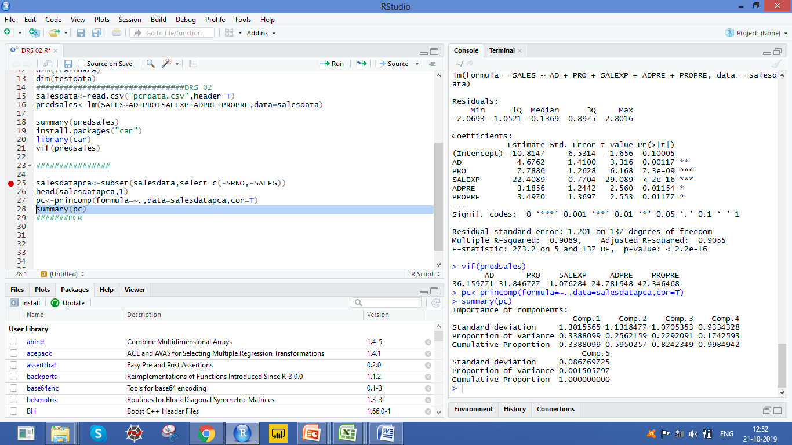
PCR in R
# Output
Interpretation:
The first three principal components explain 82% of the variation in the data. Therefore, we can use 3 PC’s in Regression Model

Slide 15
PCR in R
# PCR in R
install.packages("pls") library(pls) pcmodel<-pcr(SALES~AD+PRO+SALEXP+ADPRE+PROPRE,ncomp=3,data=salesdata,scale=TRUE) salesdata$pred_pcr<-predict(pcmodel,salesdata,ncomp=3) head(salesdata)
Install and load package pls (Partial Least Squares).
pcr() in package pls performs Principal Component Regression
ncomp=3 is the number of components to be included in the model
scale=TRUE indicates X is scaled by dividing each variable by its standard
deviation. This ensures data is standardised before running the PCR algorithm.
predict() is used to get predictions by PCR.

Slide 16
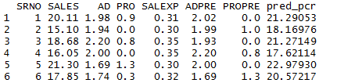
PCR in R
# Output
pred_pcr column gives predicted values of SALES using PCR.

Slide 17
Comparing Linear Regression Model and PCR model on Test data
# Importing Test Data
salesdata_test<-read.csv("pcrdata_test.csv",header=TRUE)
# Getting RMSE of linear regression model
salesdata_test$lmpredict<-predict(predsales,salesdata_test) salesdata_test$lmres<-(salesdata_test$SALES-salesdata_test$lmpredict) RMSE_lm<-sqrt(mean(salesdata_test$lmres**2))
predict () will give the predicted value for the model.
# Getting RMSE of PCR model
salesdata_test$pcrpredict<-predict(pcmodel,salesdata_test,ncomp=3) salesdata_test$pcrres<-(salesdata_test$SALES-salesdata_test$pcrpredict) RMSE_pcr<-sqrt(mean(salesdata_test$pcrres**2))

Slide 18
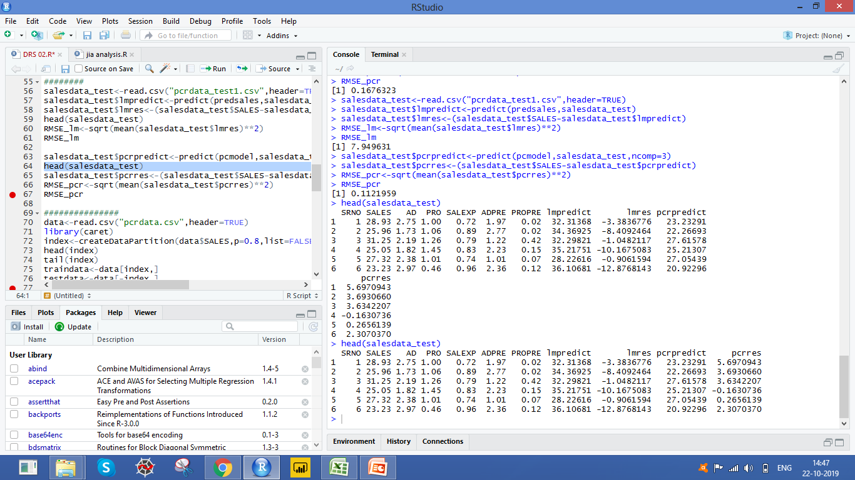
Comparing Linear Regression Model and PCR model on Test data
# Viewing data after adding predicted & residual variables
head(salesdata_test)
# Output
RMSE_lm [1] 9.111682 RMSE_pcr [1] 2.851245
Interpretation:
RMSE using PCR is less than RMSE using linear regression, we may conclude that PCR model predicts SALES better than linear regression model when multicolinearity exists.

Slide 19
Quick Recap
Multiple Linear Regression and Multicollinearity
Highly correlated predictor variables is a very frequent phenomenon in real world analytics.
Principal Component Regression
PCR is a three way process where the variables are first transformed to principal components, regression is run by considering these components as regressors and finally, they are transformed back to their original forms.
PCR in R
pcr() function in package pls performs PCR.

Slide 20
THANK YOU!

